Slide 1
The Celebrity I Admire: Elon Musk
宋泳贤
"When something is important enough, you do it even if the odds are not in your favor."
“当某件事足够重要时，即使胜算不大，你也会去做。”
Notes:
Hello everyone, today I’m going to talk about the celebrity I admire: Elon Musk.

Slide 2
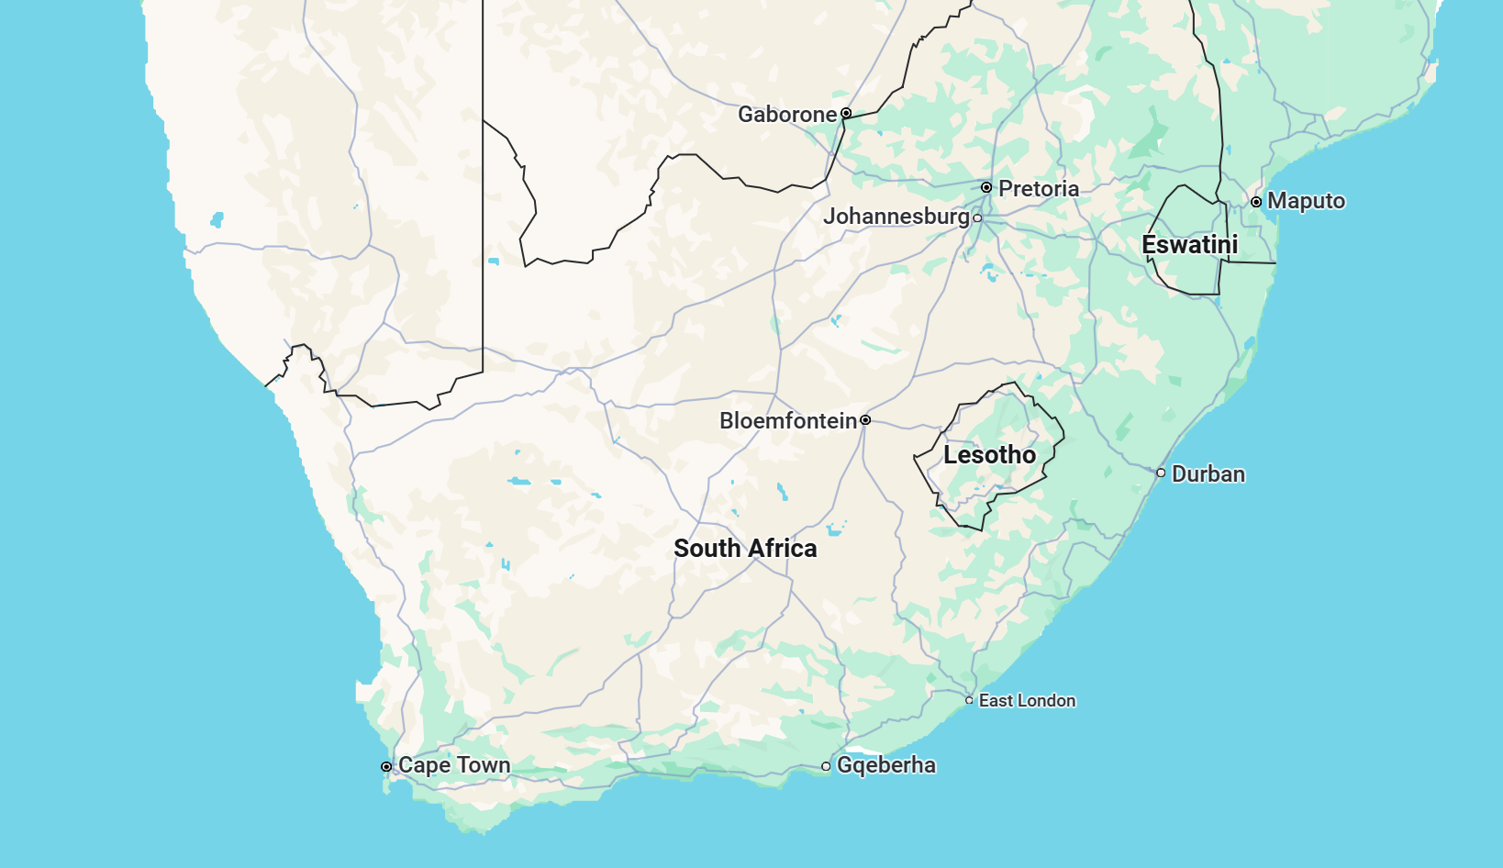

Basic Information
Birthplace: South Africa
Birthdate: June 28, 1971
Occupation: Inventor, Entrepreneur, Engineer
Notes:
Elon Musk was born on June 28, 1971, in South Africa. He is an inventor, entrepreneur, and engineer, known for his vision and innovative spirit.

Slide 3


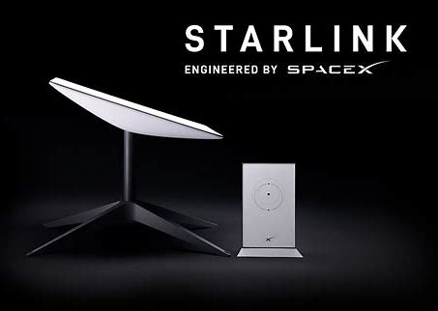
Experiences and Works
1.Tesla /特斯拉:
Leader in electric vehicles, aiming to reduce carbon emissions.
电动汽车领导者，致力于减少碳排放。
2.SpaceX /太空探索技术公司:
Making space travel affordable, with the goal of sending humans to Mars.
降低太空旅行成本，目标是将人类送上火星。
3.Starlink /星链:
Providing global satellite internet, especially in remote areas.
提供全球卫星互联网服务，特别是在偏远地区。
Tesla
SpaceX
Starlink
Notes:
Musk founded several world-changing companies. First, Tesla, which produces electric vehicles to reduce carbon emissions. Second, SpaceX, which aims to make space travel affordable and send humans to Mars. Finally, Starlink, which provides global internet service via satellites, especially in remote areas.

Slide 4
Evaluation and Achievements
Achievements /成就:
World's Richest Man
世界首富
Acquired Twitter, now X
收购推特（现为X）
Launched Starlink satellites
发射星链卫星
Overall Evaluation /总体评价:
He proves that vision and persistence can change the world.
他证明了远见和坚持可以改变世界。
His innovative spirit inspires millions to pursue their dreams.
他的创新精神激励了无数人去追求梦想。
"The future belongs to those who believe in the beauty of their dreams."
“未来属于那些相信自己梦想之美的人。”
Notes:
Musk is not only the world’s richest man but also acquired Twitter and launched Starlink satellites. His achievements prove that with vision and persistence, we can change the world. His innovative spirit inspires millions to pursue their dreams. As he said, “The future belongs to those who believe in the beauty of their dreams.”

Slide 5
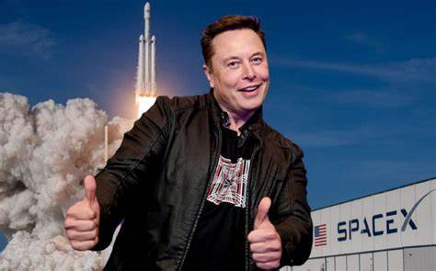
Thank you for listening!
Let’s chase our dreams together!
Notes:
Thank you for listening! Let’s chase our dreams together!

